Slide 1
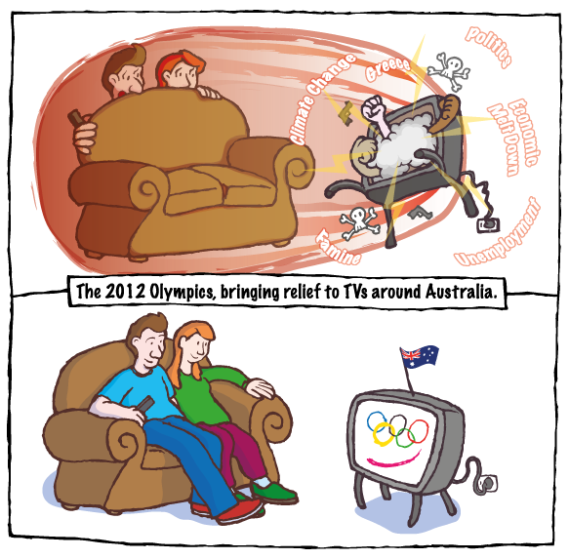
Political cartoons
Teacher Tip
Use slideshow mode.
Notes:
Let’s look at a type of cartoon called a ‘Political cartoon’.

Slide 2
What are political cartoons?
Political cartoons:
express a political or social message in a funny way
are found in newspapers and magazines
are created to make a comment about people or events at that time.
Notes:
The word ‘political’ actually comes from a Greek word, ‘politikos’ meaning ‘of’ or ‘for’ the citizens. (Click) So a political cartoon is a cartoon with a political or social message that is often drawn in a humorous or funny way. (Click) Political cartoons are found in newspapers and magazines and were around even in colonial times.
(Click) Political cartoons are most often created to make a comment about what is happening at a given time. They tell us about people or events of the time - the things that were in the news.

Slide 3
What do you see?
climate change
Greece
politics
economic meltdown
unemployment
famine
Notes:
This is a cartoon from an event that was in the news a few years ago — a political cartoon created in 2012. We are going to learn how to interpret this cartoon.
(Click) What do you see?
(Click) This cartoon has two obvious parts. Let’s look at the top part first. (Click) A couple is hiding behind the couch peering over the top to look at the television.
Compare that with the couple in the bottom drawing. (Click) A couple in front of the television– happy faces, relaxed posture.
Look at the televisions.
(Click) The television in the top part shows smoke, bolts of lightning, skull and crossbones and fists. The television is jumping around the floor!
Compare that with the television in the bottom part.
(Click) We can see an Australian flag; the Olympic rings and a pink line that looks like a mouth. The television almost looks as though it’s smiling!
This television is sitting flat on the floor – it’s not moving like the one above.
Look at the difference between the television cord going into the electrical socket in both parts.
This cartoon has words as well. (Click) Look at the words in the top part — climate change, Greece, politics, economic meltdown, unemployment, famine.
Compare this with the caption for the bottom part of the cartoon. (Click) The 2012 Olympics, bringing relief to TVs around Australia.

Slide 4
What was happening at that time?
Notes:
(Click) What was happening at that time? How does it relate to events of the time? We need to think about things that were happening in the world at the time this cartoon was published.
(Click) The top part of this cartoon refers to world events that were happening in 2012; for example, discussions about climate change, economic problems in Greece and high unemployment.
The bottom part of the cartoon refers to the 2012 London Olympic Games.

Slide 5
Visual and written language
What do the words and images tell us?
Notes:
(Click) Cartoons usually have words (written language) and images (the visual language). They make up the cartoon and we can ‘read’ them to work out the meaning. (Click)
Look at the visual language — the images and symbols used in the cartoon. Look at the written language — the words. The written language includes captions, the title and possibly speech bubbles. Together, the visual and written language gives a message. When someone wants to give a message, they want to give their point of view.

Slide 6
Interpreting the language
These people seem scared.
The world is in trouble.
The Olympics is a welcome relief from global problems.
These people are enjoying themselves.
The smile portrays happiness and pride.
Notes:
When we interpret the images and words, we interpret what we see; that is, we describe what is in the cartoon and what we think about what we see.
Firstly, we look at the different postures of the people — the way their bodies are positioned. We can interpret the different postures like this:
- In the top part, the people’s faces look frightened. (Click) They are scared and are crouched behind the couch.
- In the bottom part, the people’s bodies look relaxed and their faces look happy. (Click) They are enjoying themselves.
Look at the top television. The television is jumping around and coming from the TV are fists, skulls and crossbones, guns and smoke. (Click) This could mean bad things happening in the world like war and other crises — the world is in trouble. Now look at the bottom television. The TV is staying still and it portrays a smiling face which makes us think of happiness (Click) and the waving flag gives a sense of national pride.
Finally, let’s look at the written language: ‘The 2012 Olympics, bringing relief to TVs around Australia.’ (Click) This could be interpreted to mean that the Olympic Games is a pleasant and welcome relief from the problems happening in the world at the time.

Slide 7
Main idea
What is the main idea?
Notes:
(Click) So what’s the main idea of this cartoon? (Click) It could be that the 2012 London Olympic Games were a welcome distraction from the many problems the world was facing at the time. You must back up your conclusion with evidence and you would do this by referring to the visual and written language in the cartoon.

Slide 8
Point of view
What is the cartoonist’s point of view?
Notes:
(Click) A point of view is the opinion or stance a person has about an event, development or issue. (Click) It appears that this cartoonist’s point of view was that the world was able to have a rest from its problems while the 2012 London Olympic Games were happening.

Slide 9
Purpose
inform or educate
persuade
criticise or praise
Notes:
What is the main purpose of this cartoon? Do you think it is to (Click) inform or educate an audience about events and issues? Perhaps the main purpose is to (Click) persuade others to watch the 2012 London Olympic Games. Is the main purpose of the cartoon to (Click) praise or criticise people, events or developments at the time it was created?
After interpreting the visual and language features of the cartoon and identifying the main idea, we could say that the main purpose of the cartoon is to criticise societal stresses and problems, and to praise the 2012 Olympic Games for bringing people relief from these stresses and problems. What aspects of the cartoon help us to come to this conclusion?

Slide 10
Interpret a political cartoon
What do you see?
What was happening at that time?
What does the visual and written language tell us?
What is the main idea?
What is the cartoonist’s point of view?
What is the purpose of the cartoon?
Notes:
When interpreting a political cartoon, remember to look carefully at the visual and written language — images, symbols and words.
Think about what was happening at that time.
Identify the main idea of the cartoon, using evidence from the visual and written language as evidence.
Think about the cartoonist’s point of view. What is he or she trying to tell us?
And finally, identify the purpose of the cartoon. Why was the cartoon created?

